Slide 1
Cyclistic – A bike share company
Analysis on Different bike according to Different riders

Slide 2
Project info
The director of marketing believes the company’s future success depends on maximizing the number of annual memberships. Therefore, we wants to understand how casual riders and annual members use Cyclistic bikes differently. From these insights, We will design a new marketing strategy to convert casual riders into annual members.

Slide 3
Data cleaning
First we Combine all the tables and remove empty rows and column.
Put out date from the data – time form.
Calculate hours from given time.
Remove the data we don’t use during analysis.
Data obtain from - https://drive.google.com/drive/folders/1g9xsDHzVcW0s54aAUjOEtFWovnZxB-Ru?usp=sharing

Slide 4
Data Manipulation
Creating new group by weekly and count of rides.
Counting hours and no. of rides by hours.
Creating a summary data according to membership types and bike types

Slide 5
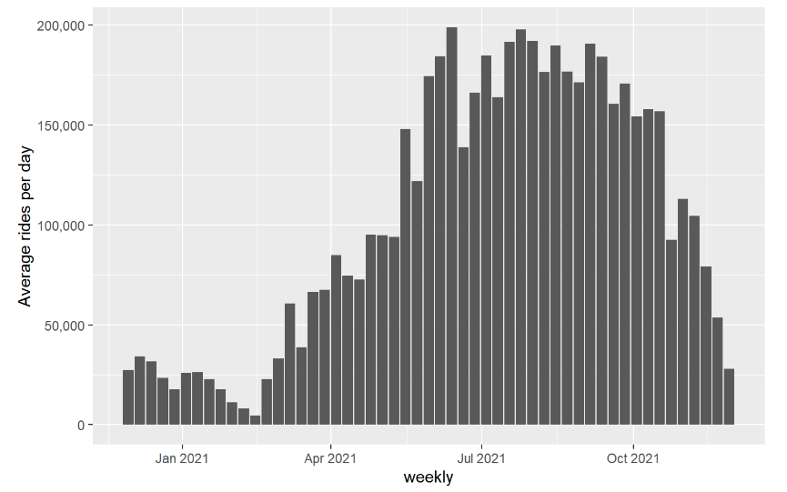
Number of rides taken in a day

Slide 6
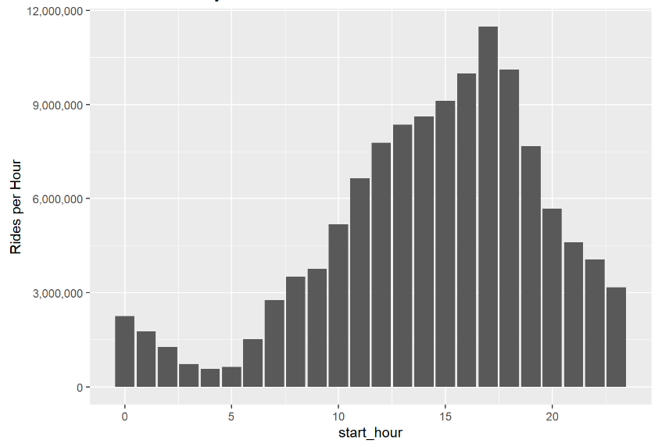
Number of rides taken in a hour

Slide 7
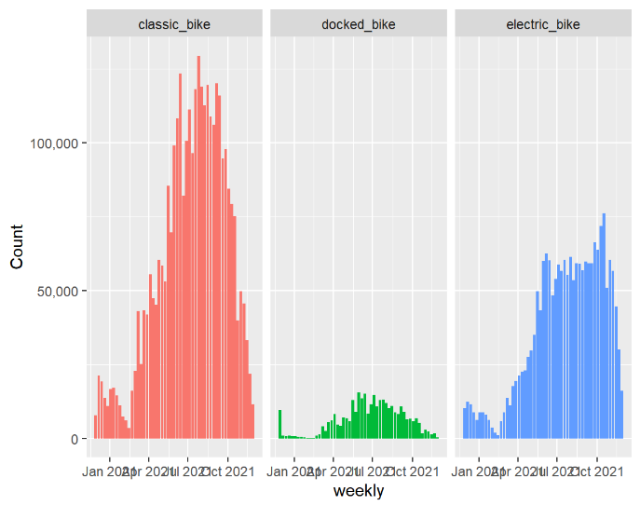
Number of different types bike in year

Slide 8
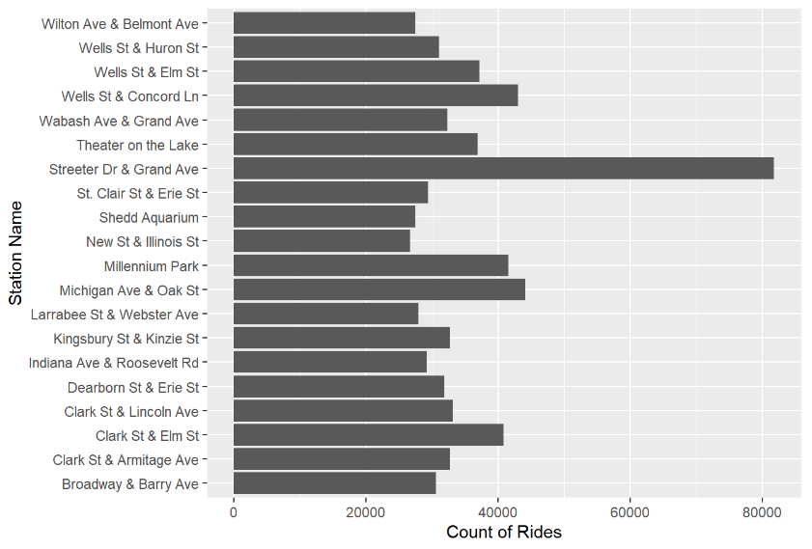
Top 20 station from where ride started

Slide 9
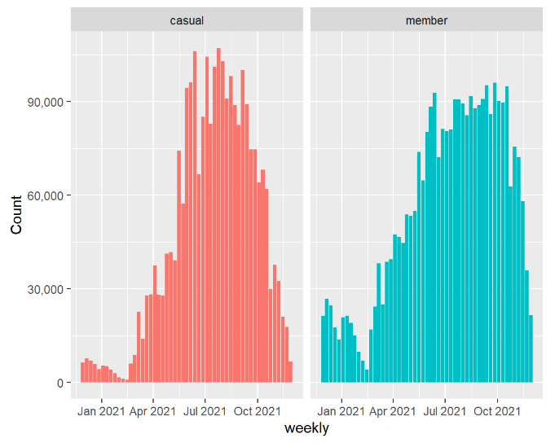
Number of rides by member and casual riders

Slide 10
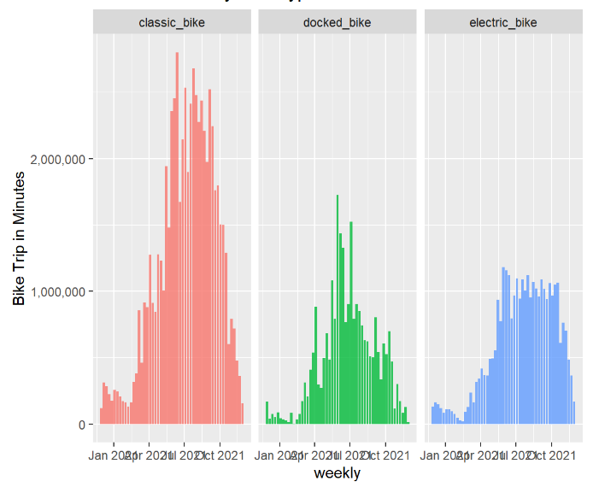
Time of bike trip(in min) by different bike

Slide 11
Conclusion
Here, We can see that number of rides taken during June to October weekend was most.
Most of the rides taken for more then 15 hour to 18 hour.
Classic bike are more likely to be chosen by riders.
Most of our riders were prefers Steeter Dr & Grand Ave station.
Member riders more ride then casual but difference is not too much.

Slide 12
Suggestions
We can see that most of casual riders rides on weekend so we can introduce an weekend pass for them for a year . Whose price is less then annual pass.
Allow extra charges to casual riders when they take rides for long time intervals ( like more then 24 hour) so they will think to by pass.
Giving prices to annual pass holders who takes most rides in a year.

